Slide 1
Week 2: HTML + CSS
October 16, 2013

Slide 2
What’s ahead
Goals
HTML
CSS
Connecting CSS to HTML
Note of Frameworks and Boilerplate
Weekly Assignment

Slide 3
Anatomy of a website
HTML: Structure/Markup
CSS: Look and Feel
JavaScript: Brains/Logic

Slide 4

Let me show you

Slide 5
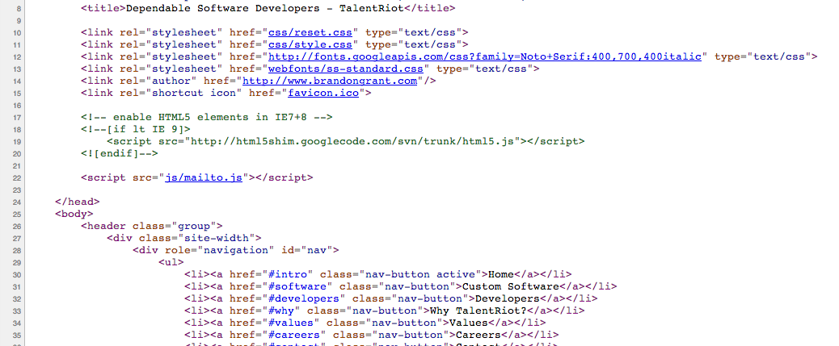
HTML: Purpose

Slide 6
HTML Terminology
Element <a>
Tags <a>…</a>
Attributes <a href=“//talentriot.com”>Talent Riot</a>

Slide 7
HTML Structure & Syntax
<!DOCTYPE html>
<html lang="en">
<head>
<meta charset="utf-8">
<title>Hello World</title>
</head>
<body>
<h1>Hello World</h1>
<p class=“hero”>This is a website.</p>
</body>
</html>

Slide 8
HEAD
<title>
<meta type=“*”>
<link src=“”>
<script></script>
<style></style>

Slide 9
BODY
<div>
<ul>
<p>
<table>
<form>
<input>
Many more!

Slide 10
Important Attributes
class=“”
id=“”
on=“”
title=“”
tabindex=“”

Slide 11
Attribute Order
class
id
data-*
for, type, href
<a class=“” id=“” data-modal=“” href=“”>Example Link</a>

Slide 12
Dos & Don’ts
Use soft tabs with two spaces
Nested elements should be indented once (2 spaces)
Always use double quotes, never single quotes
Lower-case tags
Use tables only for tabular data
Know the difference between <b>,<strong>,<em>

Slide 13
Note on SEO
<h1>,<h2>,<h3> tags
<p> tags
lists
Sitemap
Inbound links

Slide 14


Breathe

Slide 15
CSS
What’s the point of CSS
How does it work?
Definition order: top->down
Specificity

Slide 16
Connecting CSS to HTML
Inline <div style=“margin: 10px”>...</div>
Embedded <head> ... <style> .my-class { margin-left: 10px; } </style> </head>
External <link rel=“stylesheet” type=“text/css” href=“style.css”>

Slide 17
CSS Terms: Selectors
Universal
Element Type
Class
ID
Attribute
Pseudo-classes
Pseudo-elements
* { ... }
p { ... }
.class-name { ... }
#idAttr { ... }
a[src$=.png] { ... }
li:first-child { ... }
p:before { ... }

Slide 18
CSS Terms: Properties
Box
Layout
List
Table
Color
Typography
p {
padding: ...
color: ...
font-size: ...
}

Slide 19
CSS Terms: Values
cssvalues.com
Lots of em!
p {
padding: 10px;
color: #ff0;
font-size: 16px;
}

Slide 20
Combining Selectors
Descendant Selector
.nav li {
list-style: none;
}

Slide 21
Combining Selectors
Child Selector
ul>li {
list-style-type: disc;
}

Slide 22
Combining Selectors
Adjacent Sibling
h2+p {
font-color: yellow;
}

Slide 23
Combining Selectors
General Sibling (CSS3)
h2~p {
font-color: yellow;
}

Slide 24
Combining Selectors
Combination
Don’t do this
.big.yellow.button {
font-color: yellow;
}

Slide 25

Breathe

Slide 26
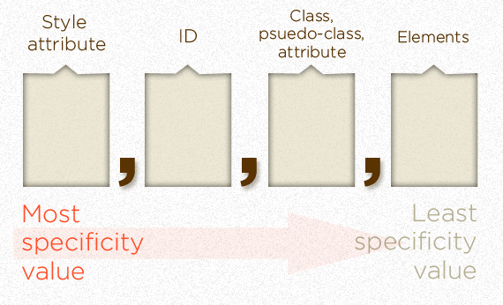
CSS Specificity
css-tricks.com/specifics-on-css-specificity

Slide 27
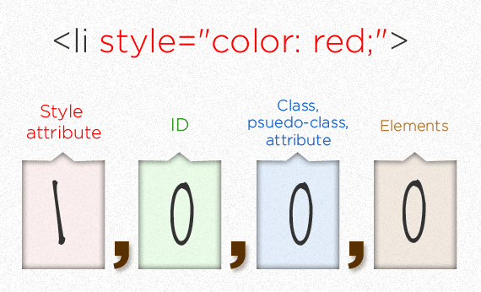
Specificity: Style

Slide 28
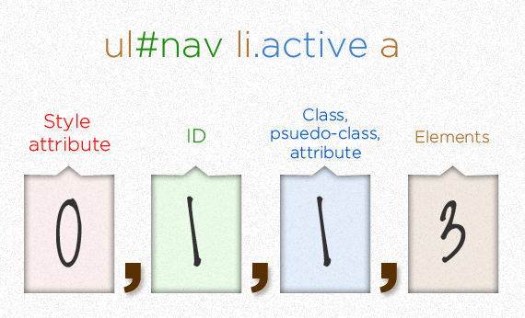
Specificity: ID, class, elements

Slide 29
Specificity Notes
The universal selector (*) has no specificity value (0,0,0,0)
Pseudo-elements (e.g. :first-line) get 0,0,0,1 unlike their psuedo-class brethren which get 0,0,1,0
The pseudo-class :not() adds no specificity by itself, only what's inside it's parentheses.
The !important value appended a CSS property value is an automatic win. It overrides even inline styles from the markup.

Slide 30
Best Practices
Avoid universal key selector * {...}
Don’t qualify ID rules with tag names or classes div#header
Avoid the descendant selector .header > .menu
Remove redundant qualifiers div#nav.item -> #nav li
Notes:
Add examples

Slide 31


Breathe

Slide 32
CSS Preprocessors
Great, familiar, smart
LESS
Stylus
SASS
Notes:
Mention that this is high level overview, we won’t go into details.

Slide 33
Front End Frameworks
Bootstrap
Foundations
Blueprint
Skeleton
Front End Frameworks Compared: usablica.github.io/front-end-frameworks/compare.html

Slide 34
Recap
HTML: Structure/Markup
CSS: Look and Feel
Connecting them together
Tools and further reading
“HTML and CSS: Design and Build Websites” by Jon Duckett

Slide 35
Assignment
Create a personal website that hyperlinks to your github/other places
Experiment with styling and layout
Commit your work and push it to the repository you’ve created

Slide 36
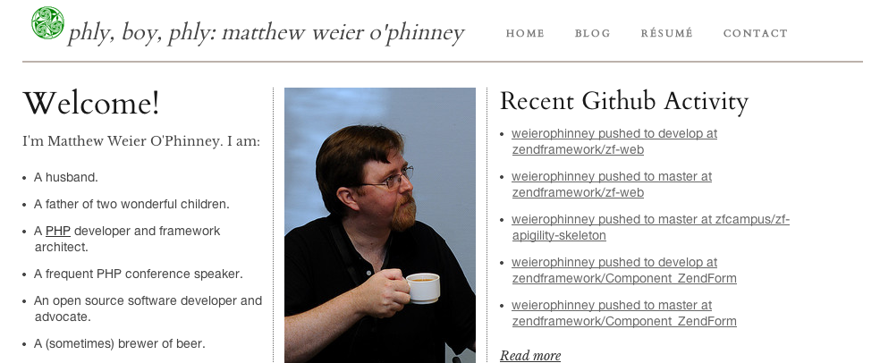
Example: mwop.net

Slide 37
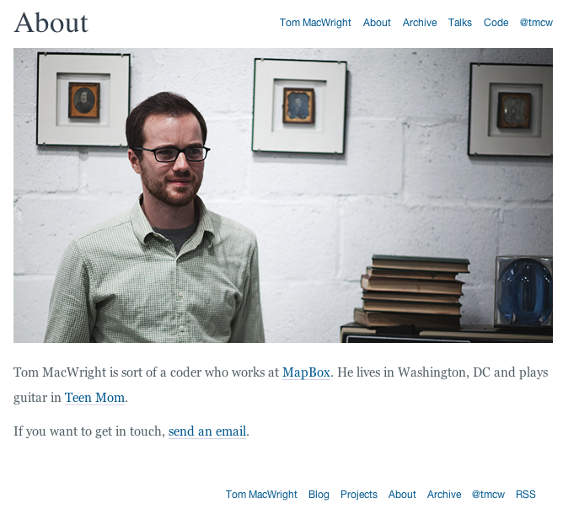
macwright.org

Slide 38
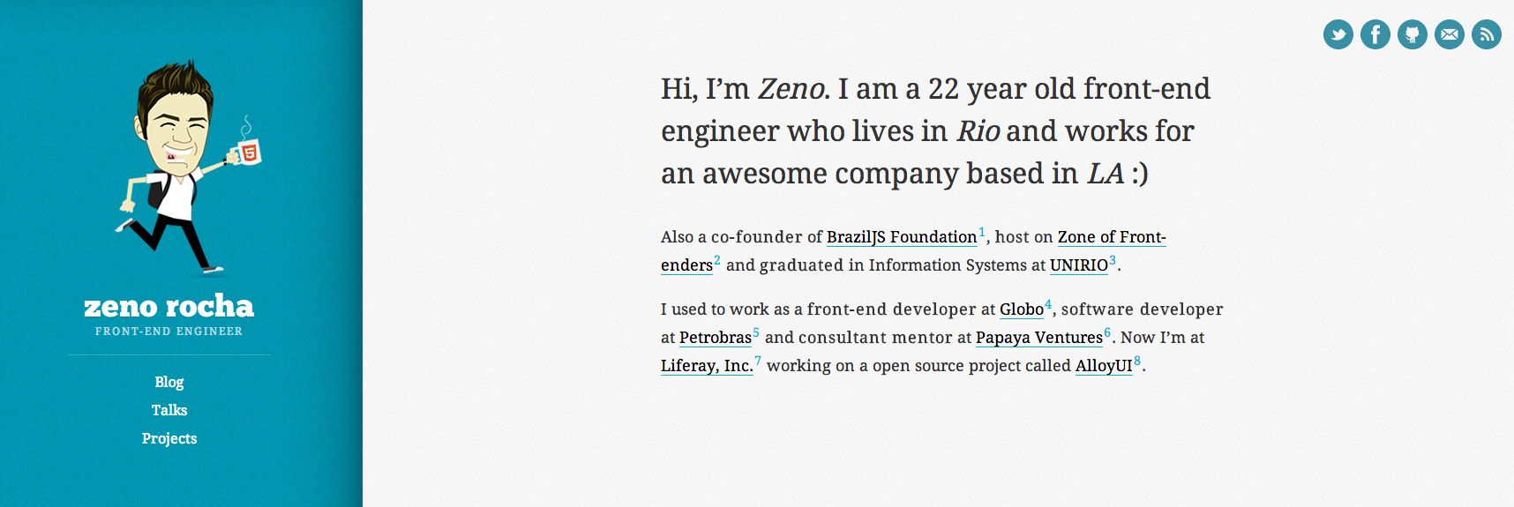
zenorocha.com

Slide 39

sberkmada.com

Slide 40
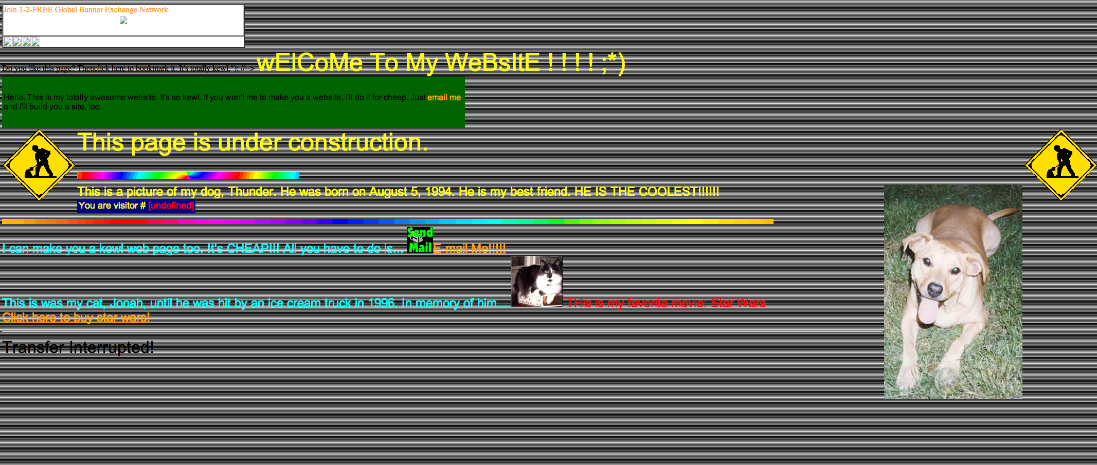
Don’t do this

Slide 41


Cya Next Week!

